Slide 1
Ranged Battle Chat
Wesley Bales, Leonardo Guajardo,
Brad Mickow, Thomas Wolf

Slide 2
Demonstration
Login Attempt for non-user
Account Creation
Login
Send Message
Notes:
5 minutes for project, 2 minute for Git Repo

Slide 3
Git Repository
Show Git commits
Pull requests
Commit messages
Notes:
Pull up the Git page on the CP that we are demonstrating on
Display the contributor page that shows total commits
Click a user and show the detailed commit page

Slide 4
Team Organization and Design
Met weekly after class for quick touch and go meetings
Communicated through GroupMe
Used pair programming and often worked as a group on tasks
Notes:
3 minute, 1 minute for discussion and meeting, coding style, and for design.

Slide 5
Coding Styles
Primary coding convention was camelCase
JavaDoc was used in Android Studio java files
We mostly used comments to describe classes and methods, and did not write comments for all lines.

Slide 6
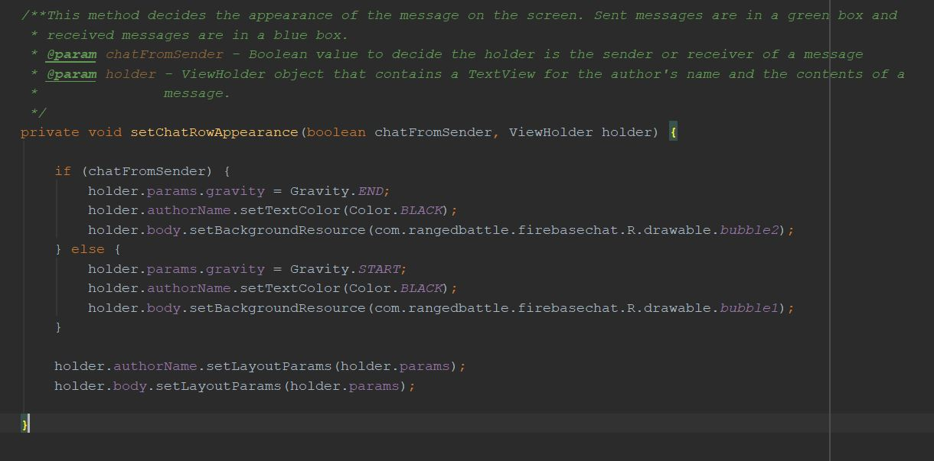

Slide 7
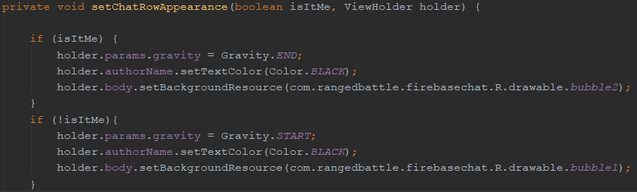
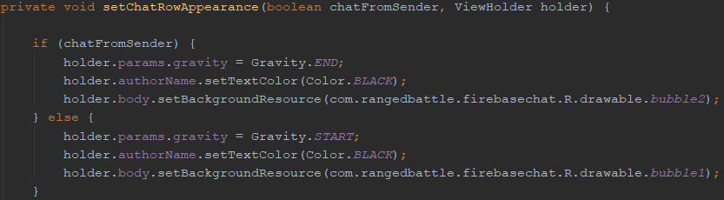
Refactoring
Notes:
Needs

Slide 8
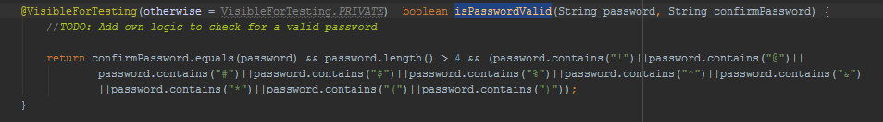
Testing
This is the method that was chosen for the unit testing phase RegisterActivity.isPasswordValid it must be at least four Characters long and contain at least one symbol .

Slide 9
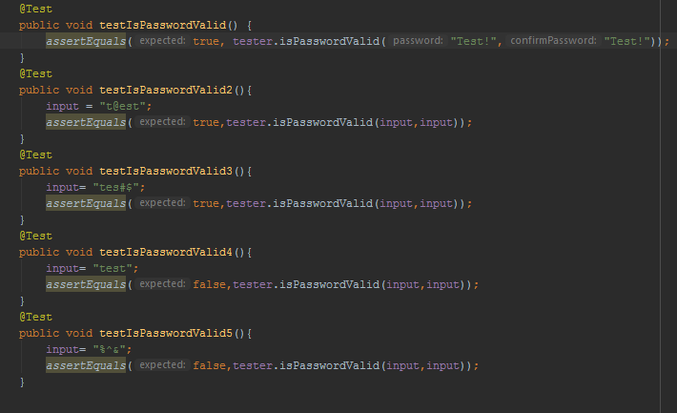
Testing

Slide 10
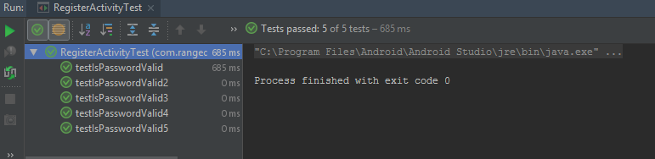
Testing
All five test passed, three expected True, two expected False.

Slide 11
Q&A

Slide 12
Contact
Wesley Bales - wrb160330@utdallas.edu
Leo Guajardo -
Brad Mickow - bam171230@utdallas.edu
Thomas Wolf - trw160130@utdallas.edu

